Slide 1
Python Bootcamp
Week 3

Slide 2
Week 2 Objectives
Conditionals
Loops
While
For
Break, Continue, Pass

Slide 3
Conditional
Execute a set of statements if a condition is met
E.g.
if 5 < 4:
print(“5 is smaller than 4)
else:
print(“5 is larger than 4”)

Slide 4
Conditional
if… elif… else…
Program checks if the conditional for ‘if’ is true, then each of the ‘elif’ conditions. If the above are untrue, the block of statements under ‘else’ will run
E.g.
a = 4
b = 5
if a > b:
print(“a is larger than b”)
elif a == b:
print(“a is equal to b”)
else:
print(“a is smaller than b”)

Slide 5
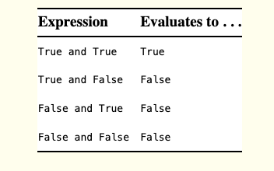
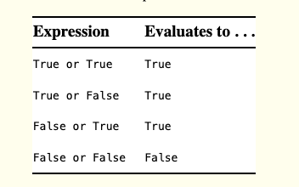
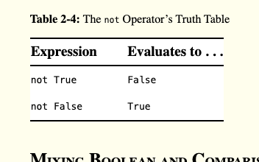
Truth Table
and
or
not

Slide 6
Conditions
(Python Logic Conditions)
Same as mathematics
Given that a = 1, b = 2:
Equals | a == b | False
Not Equal | a != b | True
Less than | a < b | True
Greater than | a > b | False
Less than or equal to | a <= b | True
Greater than and equal to | a >= b | False
* Note the double ‘=’ for equals * When there are 2 symbols for a logic condition, ‘=’ comes last

Slide 7
Exercise
Write a program that takes 2 inputs: num1 and num2.
Output the larger number.
If they are the same, output ‘same’.

Slide 8
Loops

Slide 9
While Loops
Execute a set of statements as long as a condition is true.
e.g.
i = 1
while i < 4:
print(i)
i += 1
Notes:
Draw flow chart to demonstrate output

Slide 10
While Loops
Execute a set of statements as long as a condition is true.
e.g.
i = 1
while i < 4:
print(i)
i += 1
Output:
1
2
3
Notes:
Draw flow chart to demonstrate output

Slide 11
For Loops
Iterates over a sequence
E.g.
for i in range(5):
print(i)

Slide 12
For Loops
Iterates over a sequence
E.g.
for i in range(5):
print(i)
Output:
0
1
2
3
4

Slide 13
For Loops
Iterates over a sequence
E.g.
for i in range(5):
print(i)
for j in [‘a’ , ‘b’ , ‘c’]:
print(j)
Output:
0
1
2
3
4

Slide 14
For Loops
Iterates over a sequence
E.g.
for i in range(5):
print(i)
for j in [‘a’ , ‘b’ , ‘c’]:
print(j)
Output:
0
1
2
3
4
Output:
a
b
c

Slide 15
Exercise
Write a program to print numbers 2 to 8 inclusive, using either a while or for loop

Slide 16
End

